Slide 1

Natural Language Processing Course Text Representation
Ivo Bernardo – Udemy Course

Slide 2

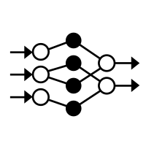



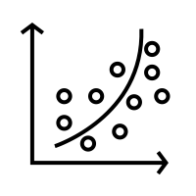
Text Representation – Machine Learning Models

Slide 3

Text Representation – Machine Learning Models

Slide 4
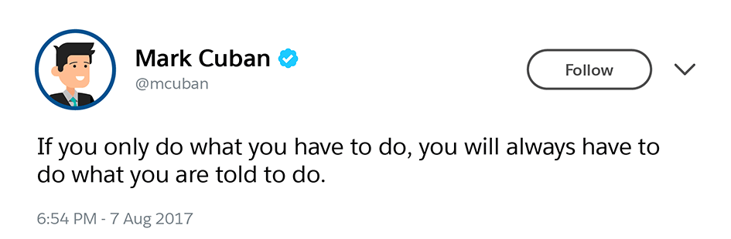
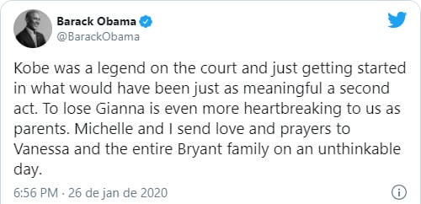
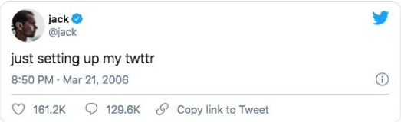
Text Representation – Machine Learning Models

Slide 5

Text Representation – Machine Learning Models
I really liked this restaurant
I did not like the food in the restaurant

Slide 6

Text Representation – Machine Learning Models
Vocabulary!
i, really, liked, this, restaurant
did, food, i, in, like, liked, not, really, restaurant, the, this
i, did, not, like, the, food, in, the, restaurant
Bag-of-words approach!

Slide 7
Text Representation – Binary Representation approach
did, food, i, in, like, liked, not, really, restaurant, the, this
i, really, liked, this, restaurant
0, 0, 1,0, 0, 1. 0, 1, 1, 0, 1
i, did, not, like, the, food, in, the, restaurant
1, 1, 1,1, 1, 0. 1, 0, 1, 1, 0

Slide 8
Text Representation – Count Vectorizer approach
did, food, i, in, like, liked, not, really, restaurant, the, this
i, really, liked, this, restaurant
0, 0, 1,0, 0, 1. 0, 1, 0, 0, 1
i, did, not, like, the, food, in, the, restaurant
1, 1, 1,1, 1, 0. 1, 0, 1, 2, 0

Slide 9
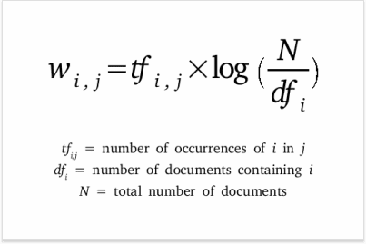
Text Representation – TF-IDF approach
food, restaurant
?, ?
i, really, liked, this, restaurant
i, did, not, like, the, food, in, the, restaurant
?, ?

Slide 10




Text Representation – TF-IDF approach
food, restaurant
i, really, liked, this, restaurant
0, 0
i, did, not, like, the, food, in, the, restaurant
0.3, 0

Slide 11
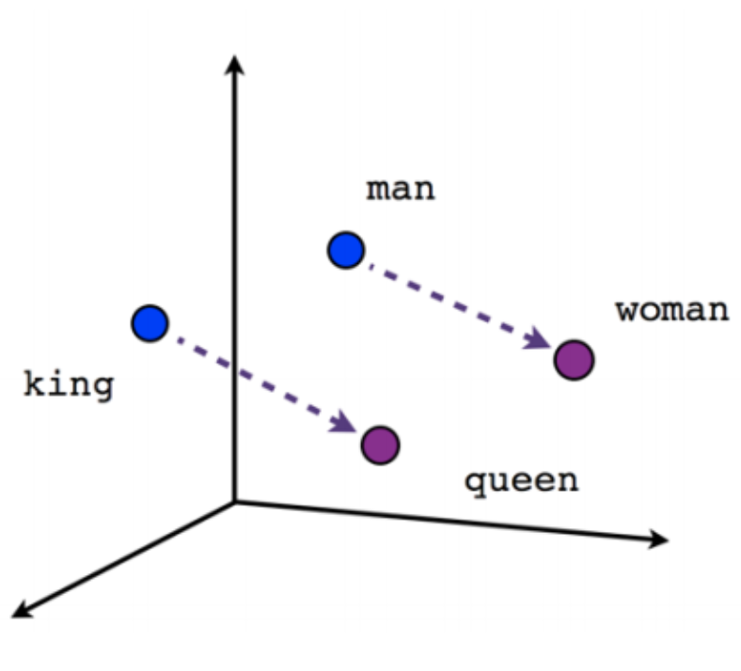
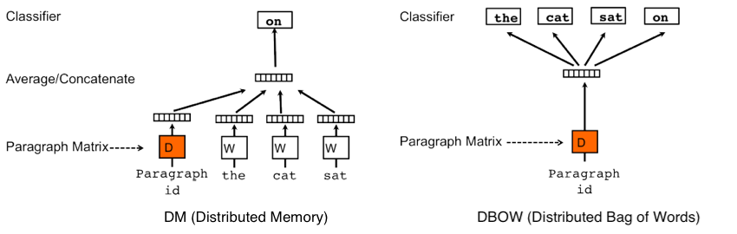
Text Representation – Other Approaches

